Slide 1
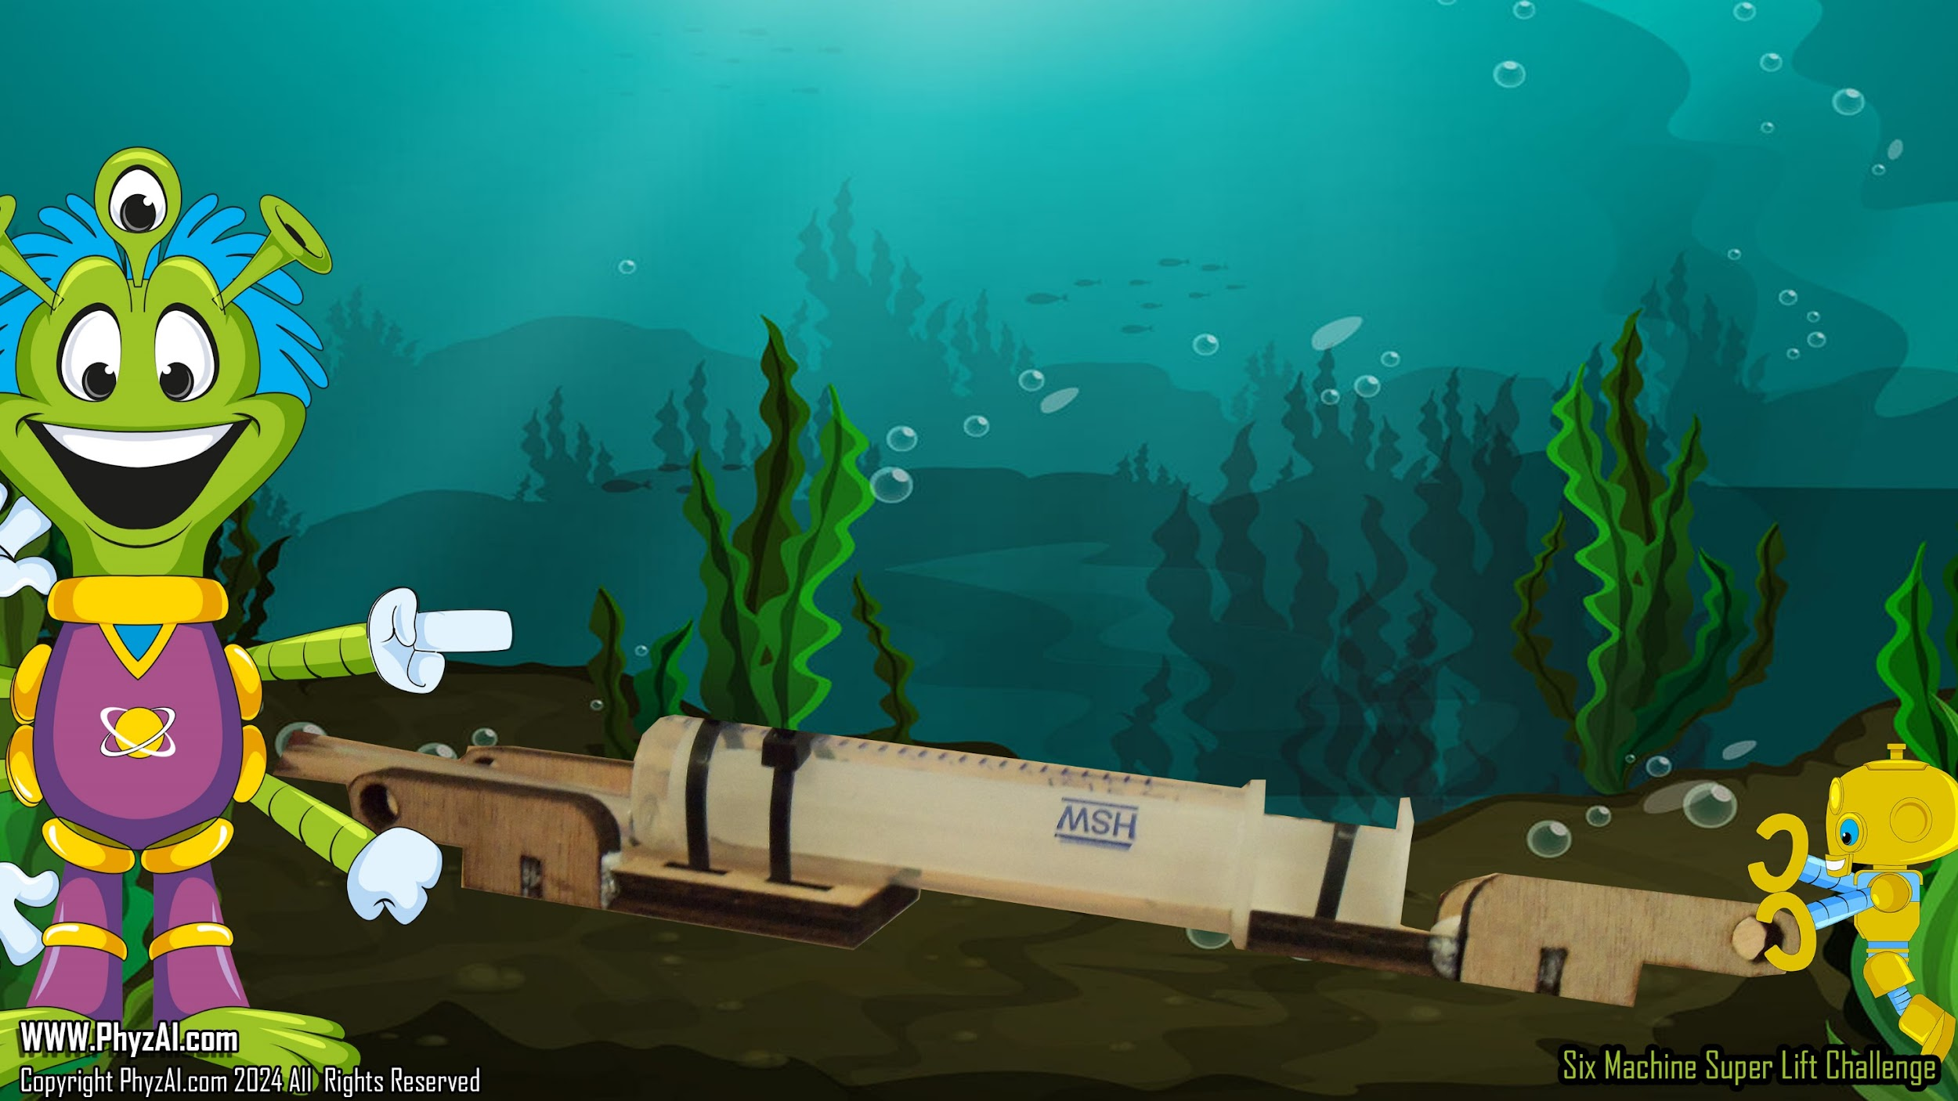
Six Simple Mechanical Machines in the Super Lift Challenge
Hydraulics
Notes:
Earthlings, let’s introduce you to hydraulics and how to utilize them in the design and building of your Super Lift Challenge.

Slide 2

A Hydraulic cylinder (also called a linear hydraulic motor) is a mechanical actuator that is used to give a unidirectional force through a unidirectional stroke. It has many applications, notably in construction equipment manufacturing machinery, and civil engineering.
Cylinder
PISTON
Notes:
Hydraulics are devices that utilize fluid pressure to create forces to move objects. Devices that use fluids to transmit pressure from one point to another are called hydraulic devices.

Slide 3

When the piston is forced
into the cylinder from an outside force, the contents of the cylinder become pressurized equal to the pressure being applied to the piston.
Cylinder
Pressure
PISTON
Notes:
Hydraulic devices use liquids because they cannot be compressed or squeezed. This property allows liquids to transmit pressure more effectively than gases which can be compressed a great deal.

Slide 4

That pressure needs to go someplace and we harness that pressure to move, lift or pull a working load.
Cylinder
PISTON
Notes:
A change in pressure can be utilized and harnessed to push, to pull, or to exert a force on any load.

Slide 5

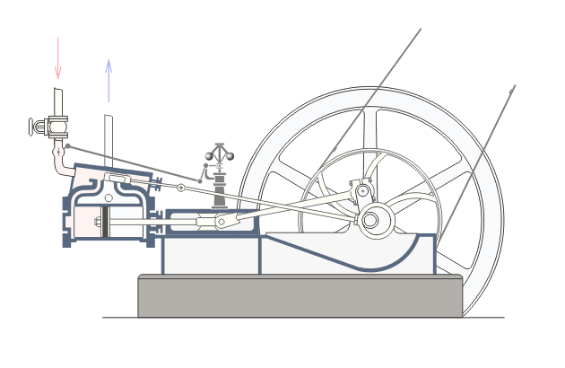
In complicated machines, that pressure can be used to drive a motor, run a generator, or move a locomotive.
Notes:
A great example of a hydraulic device that is used everyday are the brakes in your car. When a driver depresses the brake pedal in a car, they're exerting pressure on a cylinder of liquid placed right underneath that brake pedal. That liquid pressure is then exerted equally to all the brake pads on all four wheels of the car, bringing the car to a stop. This is a great example of how the pressure from the driver's foot is magnified by this hydraulic device in such a way that it brings a car to a complete stop.

Slide 6

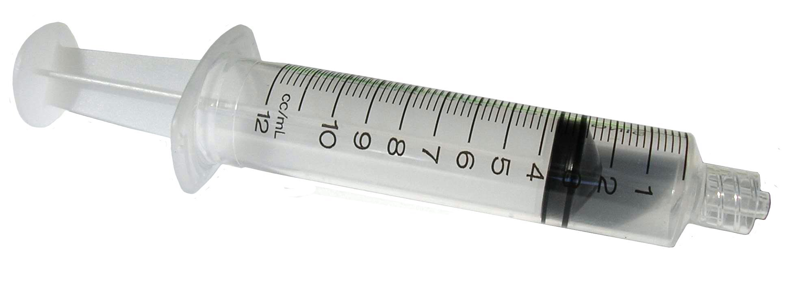
In the Super Lift Challenge we use a standard medical syringe for our piston and cylinder because it has all the same parts.
Notes:
For your Super-Lift, you'll be utilizing standard medical syringes that will magnify the effort force supplied by your fingers into the Super-Lift.

Slide 7

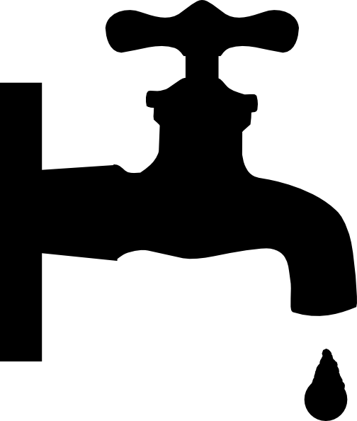
For hydraulic fluid, we use standard tap water because is free, easy to get, is safe to use and it makes a very good hydraulic fluid.
Notes:
One of the cheapest and easiest hydraulic fluids to use is water or H2O. This is a hydraulic fluid that you'll be using in your hydraulic device.

Slide 8
If you place a syringe into a cup of water and pull, you will fill the chamber up with water.
Notes:
You can fill your medical syringes in a variety of ways but one of the easiest ways to do this is to place the tip of it into a container of water and pull back on the plunger.

Slide 9

When you press on the end of the syringe, you will force the water to go out.
Notes:
Once your syringe is filled, if you add effort force to the plunger, you can push the water back out of the same tip that it was pulled in through.

Slide 10


LOAD
Connecting two syringes end to end, you will find
that as you push water out of one, you force it into the other.
If we use syringes of the same volume, like the
ones in your kit, you will get equal movement on
each side.
You can also pull the syringe and suck the water from the other connected syringe.
Notes:
Connecting two syringes end to end, you will find that as you push water out of one, you force it into the other.
If we use syringes of the same volume, like the ones in your kit, you will get equal movement on each side.
However, if you were to cap the tip of your syringes with clear surgical tubing and attach another syringe on the other end, you could use the fluid pressure inside to lift the load. How much of a load you can lift is dependent on how much pressure is exerted by your finger on one end of the system.

Slide 11
With this method we can Pull, Lift, Push or Drag a load or weight.
LOAD
Lift
Lift
LOAD
Push
LOAD
Pull
Notes:
These hydraulic devices can then be attached to your Super-Lift to create a pull, a push, or a lift.

Slide 12
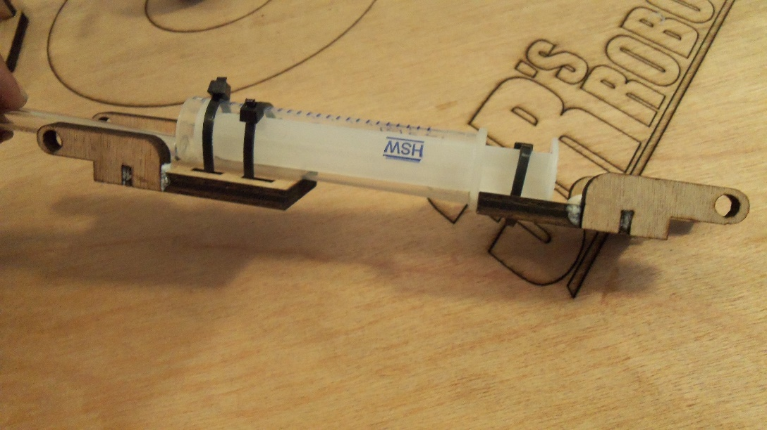
This is the system we use in our Super-Lift Challenge.
Notice the band or wrapped wire we use to keep the hose from popping off when we apply pressure.
Notes:
It is important to be mindful of how much effort force you apply into this hydraulic system. If you apply too much effort force, you run the risk of popping off one of the surgical tubings attached to the syringes. But don't worry. The hydraulic fluid used is water and it's easy to clean up and replace.

Slide 13

Let’s see some ways we can connect a cylinder and piston to our machines.
Notes:
There are many configurations you could use when attaching your hydraulic system to your Super-Lift. Let's take a look at some of those ways right now.

Slide 14

Basic Pull
Notes:
This is an example of the hydraulics being used in a pulling fashion in this first class lever to lift the load.

Slide 15
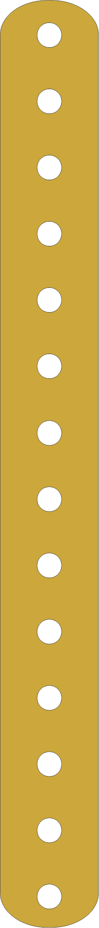
Twin A-Frame Lever
Notes:
In this example, two hydraulic systems are being used to push the load up off the platform. By using two hydraulics here, you're effectively doubling the amount of force being applied to the load.

Slide 16
String Puller
Notes:
While this system offers little mechanical advantage, the force applied by the hydraulic system here is applied over a greater distance offering greater lift of the load.

Slide 17

Complex machines can become very effective with hydraulics.
50% Effort
Load
50% Effort
Counterweights
Notes:
The hydraulics that you incorporate into your Super-Lift design will take the effort force from your fingers and magnify it through your complex machine to lift the load off of the surface of the platform.

Slide 18
Notes:
Various designs within your Super-Lift can take the force applied by the hydraulics and change its direction.

Slide 19
Notes:
Various other design features of your Super-Lift can take the force applied by the hydraulics and change the distance over which that force is applied.

Slide 20
Always be careful of getting air in your cylinder.
Notes:
Getting air into your hydraulic system could be problematic. As we mentioned before, gas is much more compressible than liquids making it an ineffective transmitter of force throughout the closed system.

Slide 21
When applying pressure the air will compress a small amount
Notes:
The compressibility of the gas will reduce the effective transfer of force throughout your hydraulic device making it less effective.

Slide 22
However, when pulling suction on the line the air will expand to create a vacuum and will you will lose much of your force.
Notes:
As evidenced here, it is always better to use your hydraulic system to push rather than to pull loads. By pulling loads, you could potentially run the risk of creating vacuums within the system causing the hydraulic device to become less effective.

Slide 23
Looking at these entries from other schools, can you tell how they used cylinders and pistons to give them mechanical advantage and control in their lift attempts?
Notes:
In the slides that follow, notice the numerous ways in which the hydraulic devices have been incorporated into the Super-Lift designs. Identify the designs that you think best give mechanical advantage and control in the lift of the load off of the platforms.

Slide 24

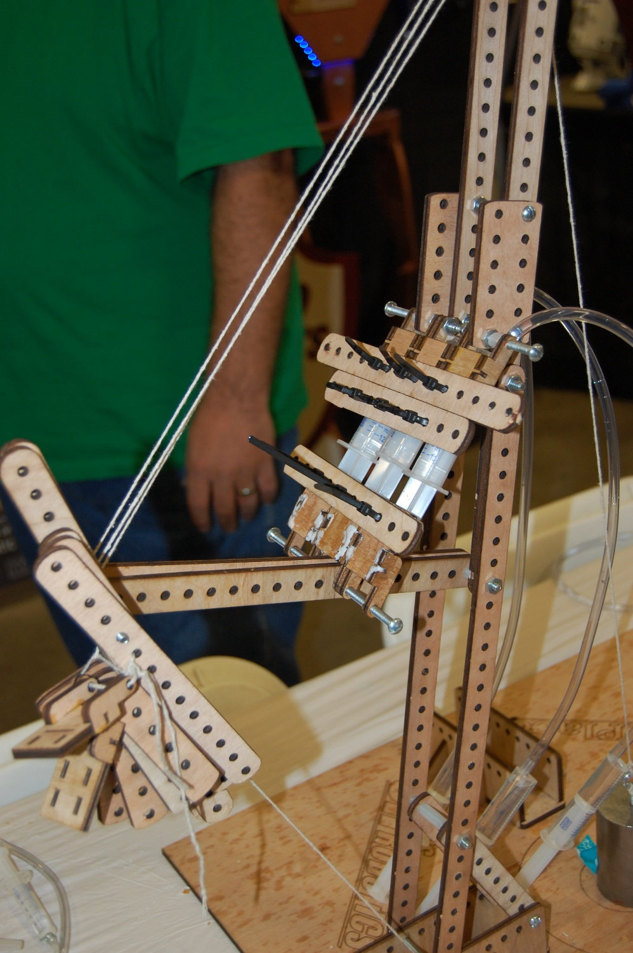
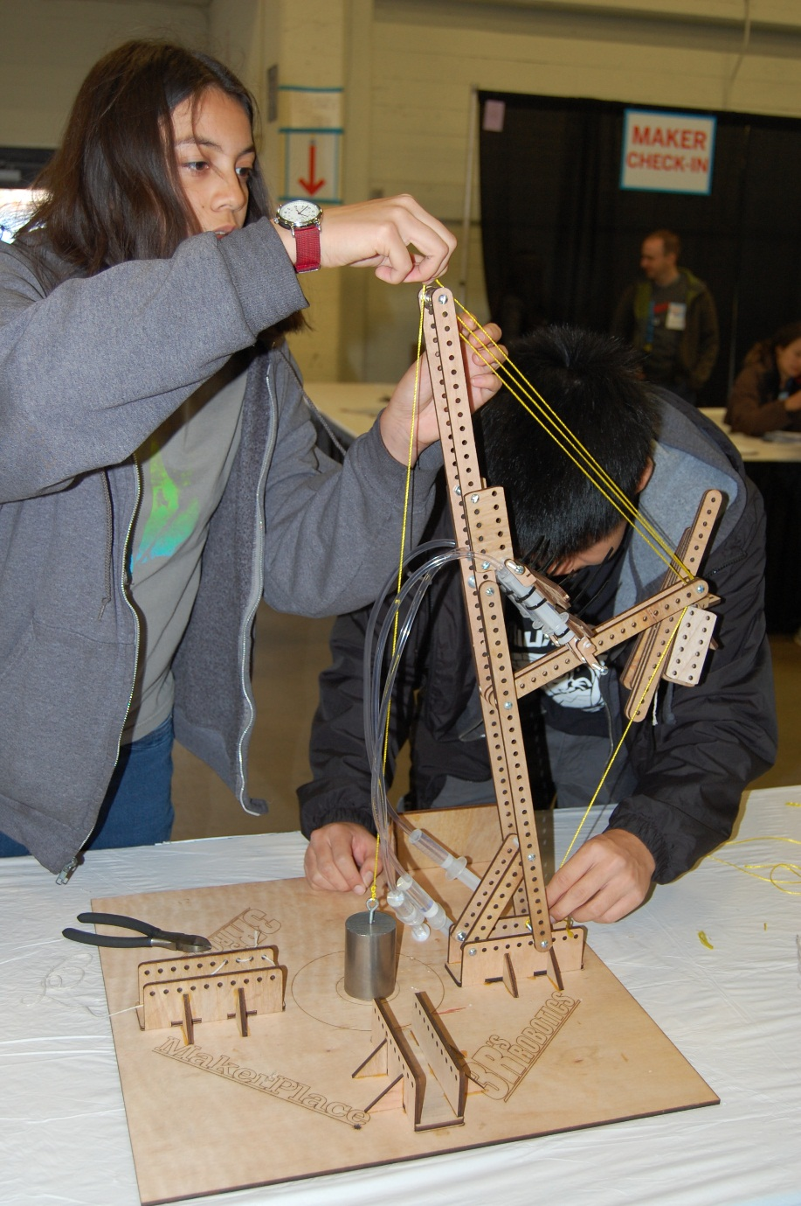
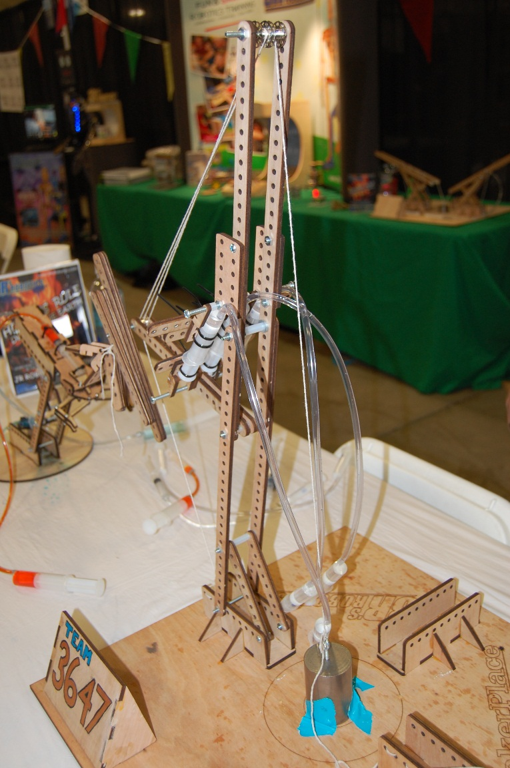

Slide 25
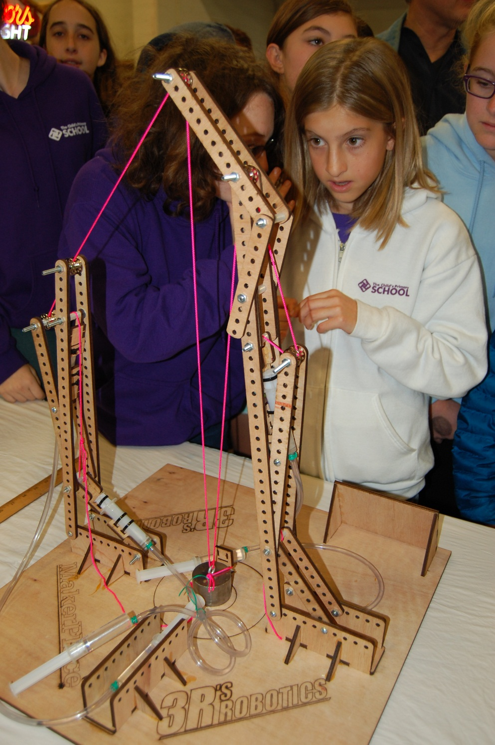
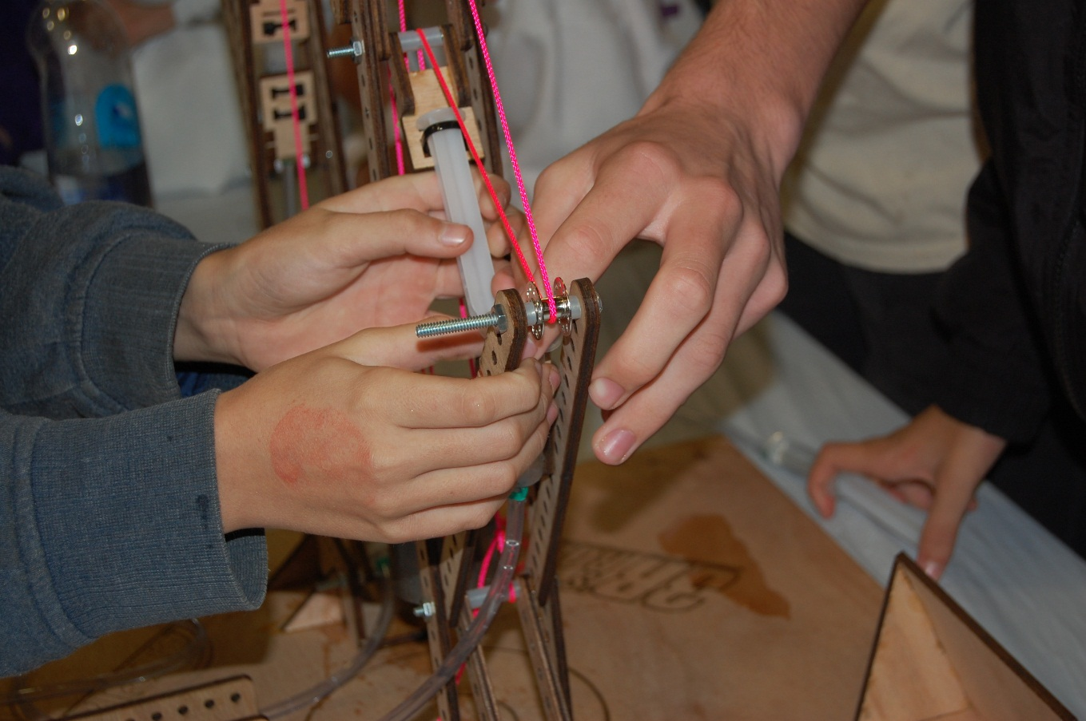
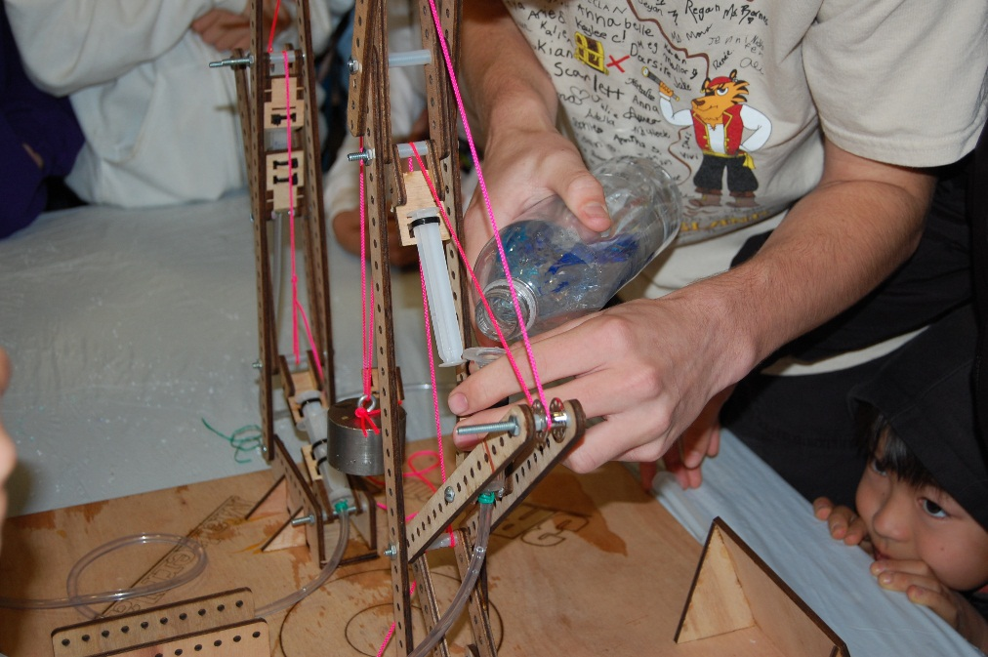

Slide 26
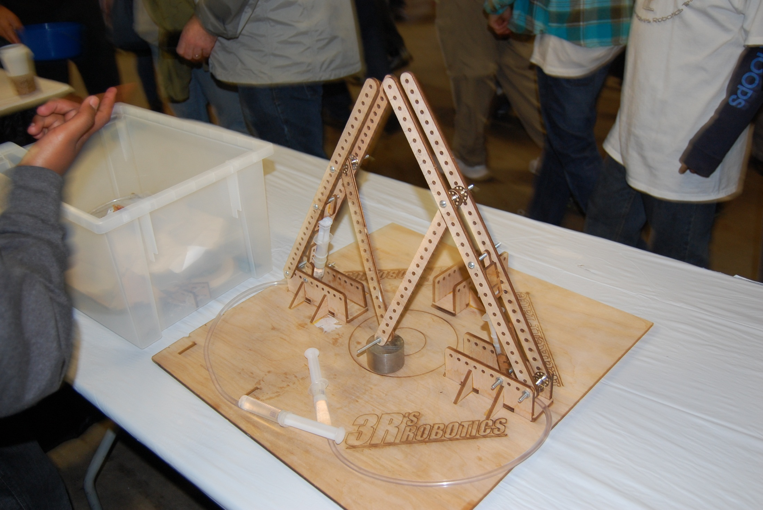
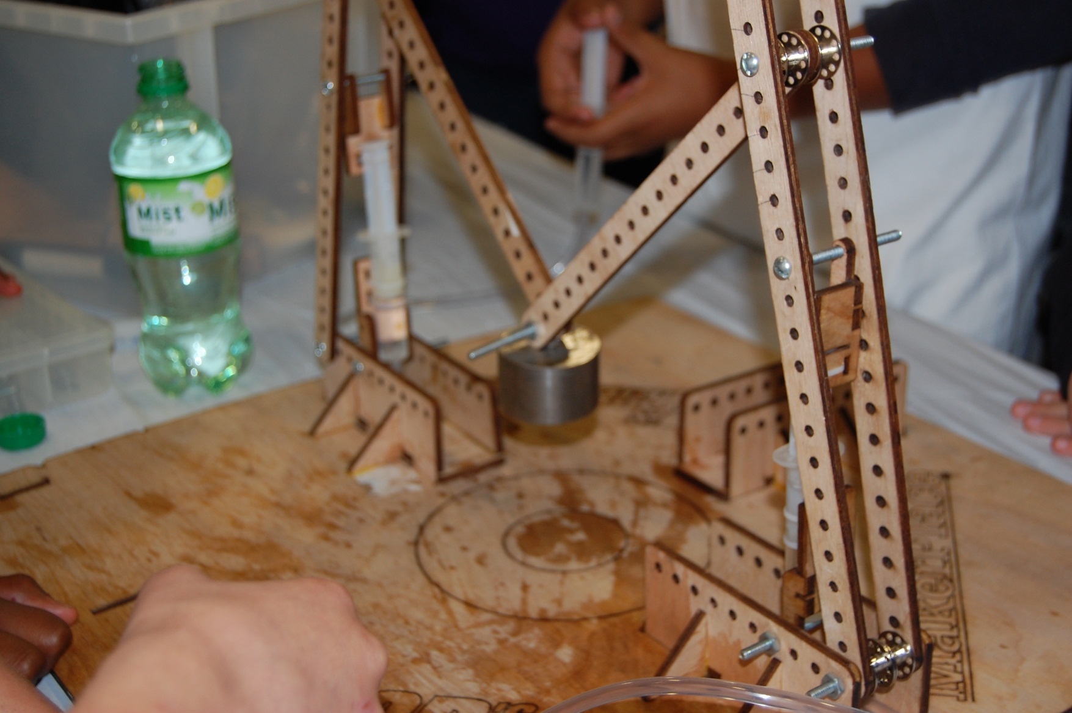
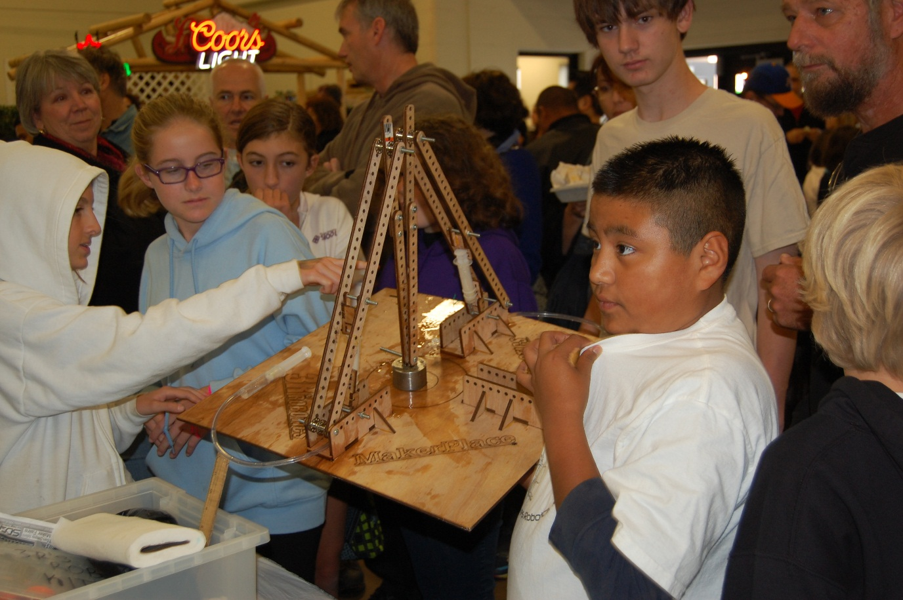

Slide 27
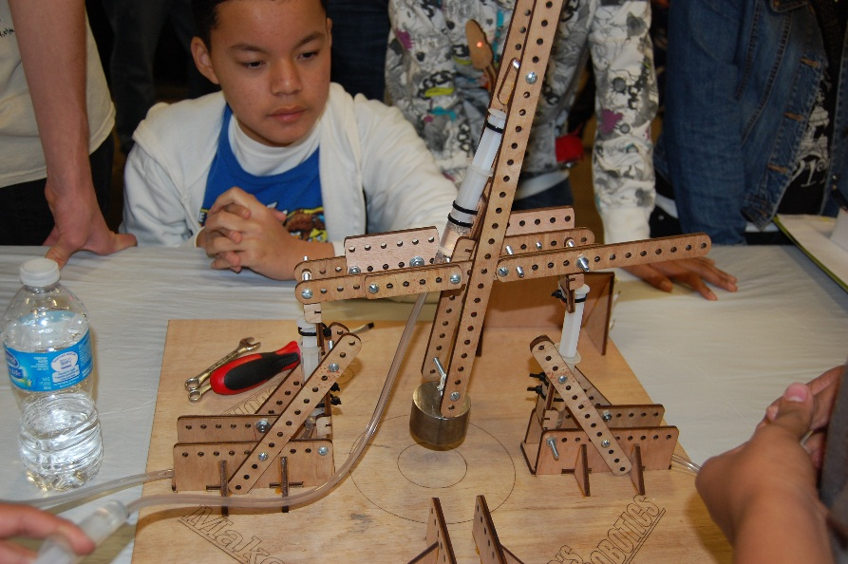
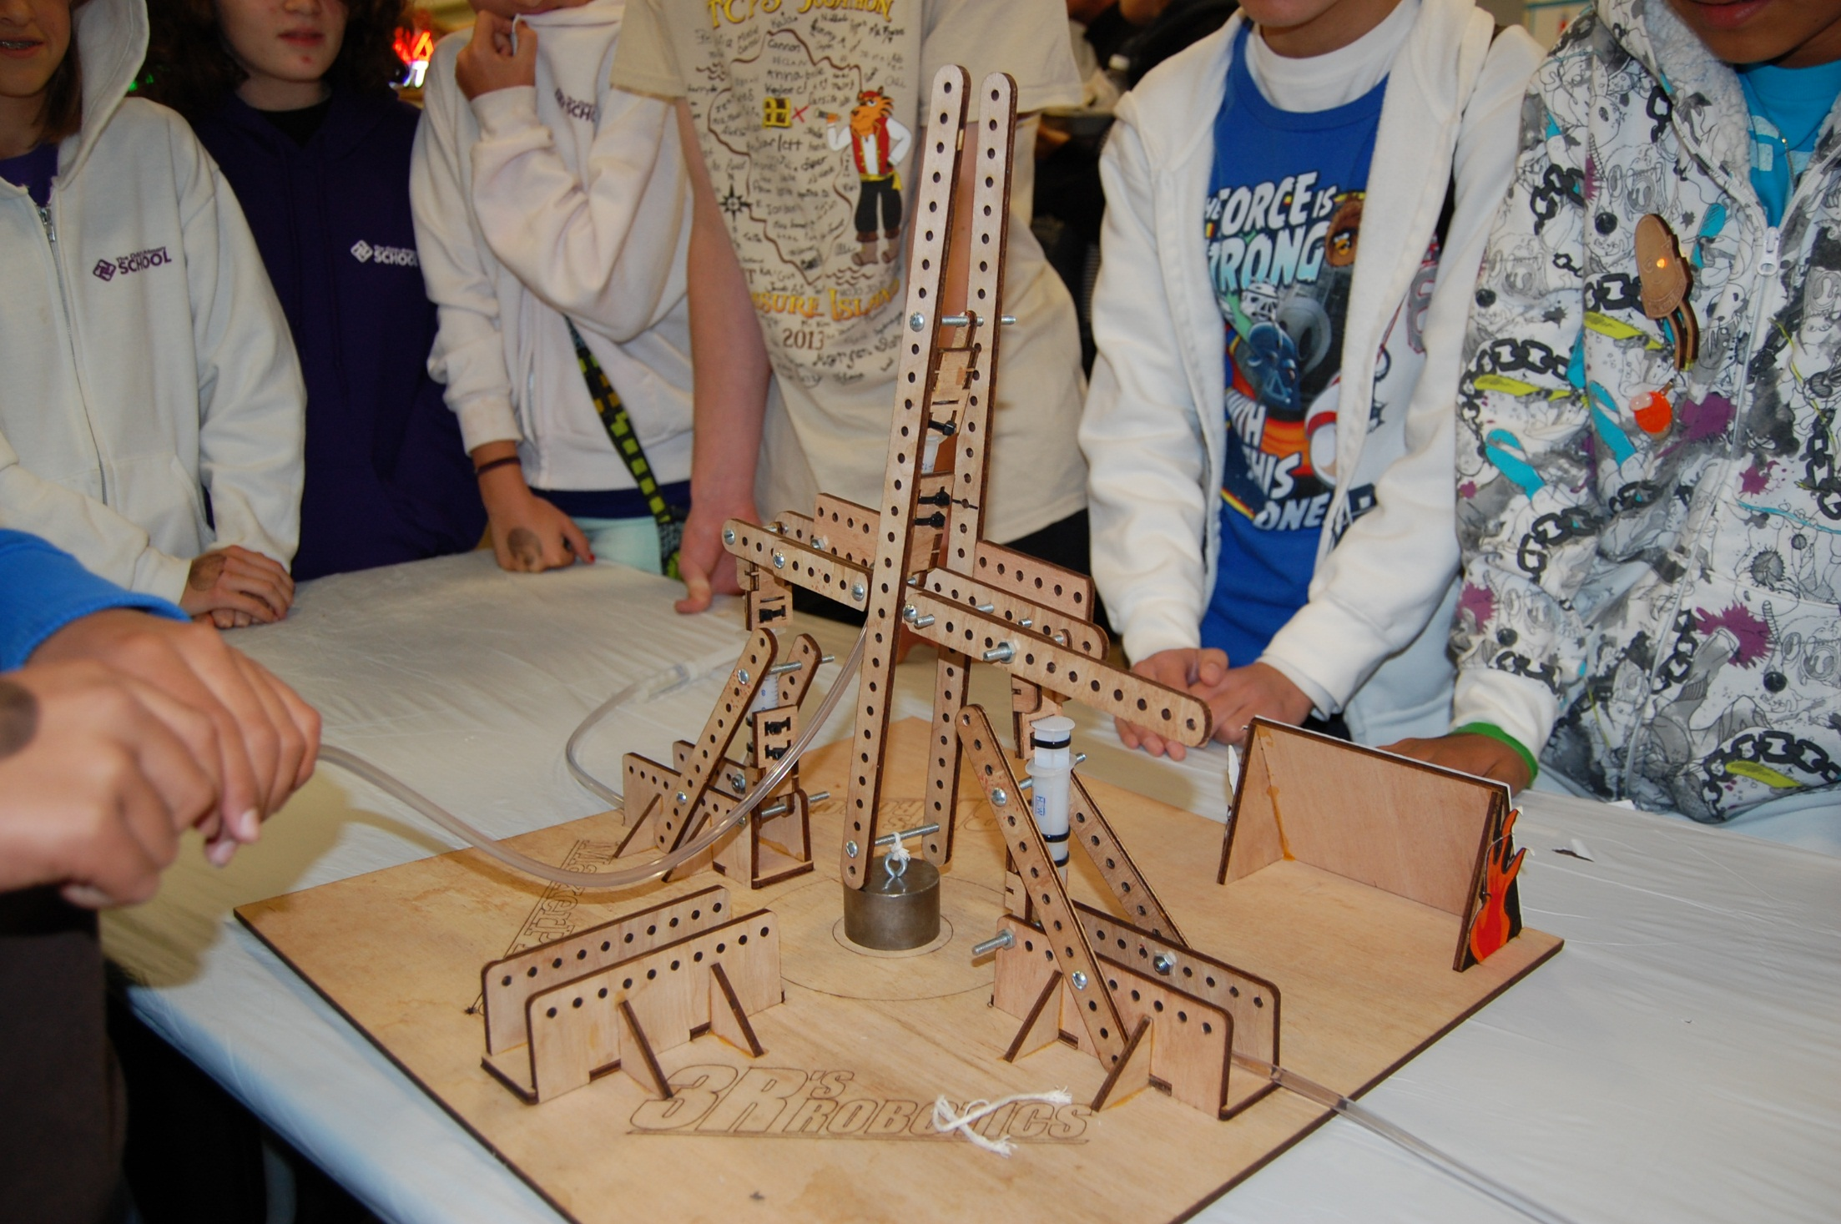
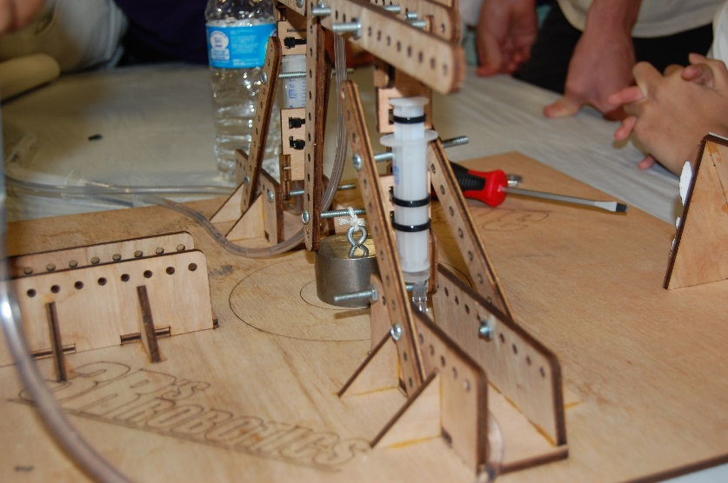
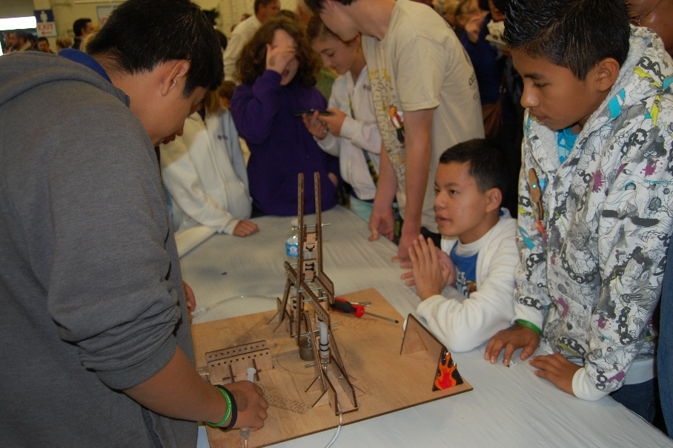

Slide 28
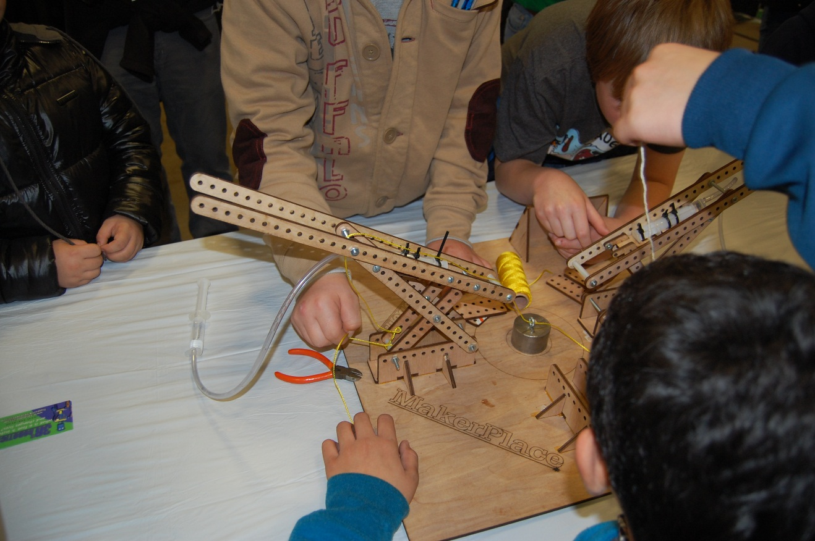
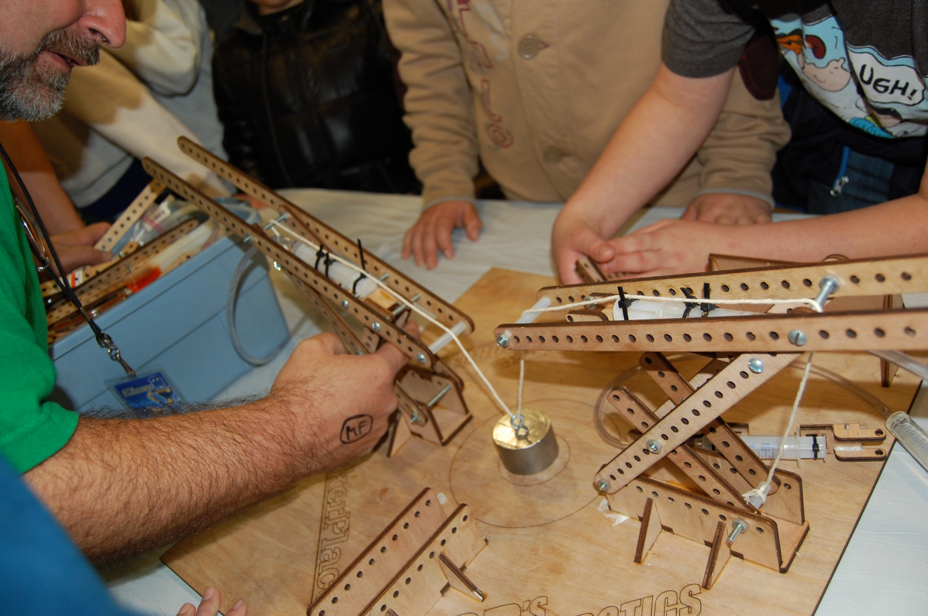
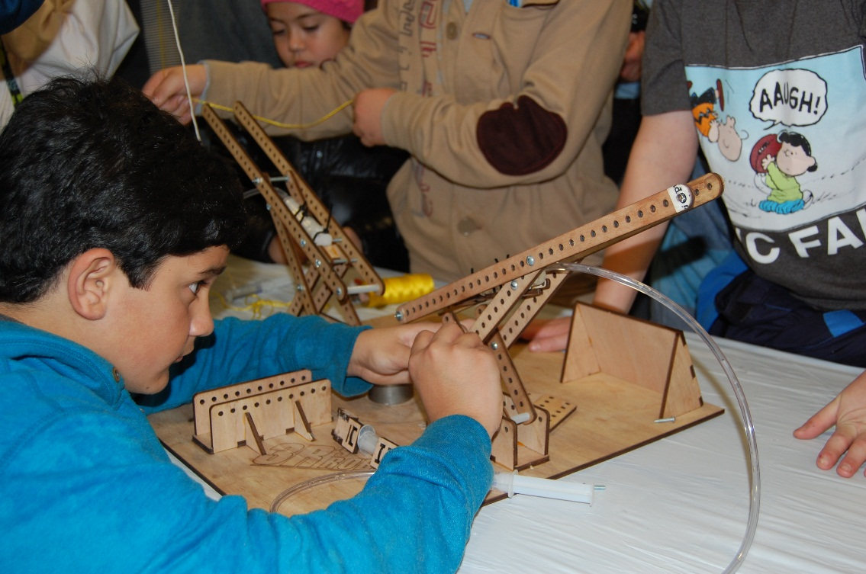

Slide 29
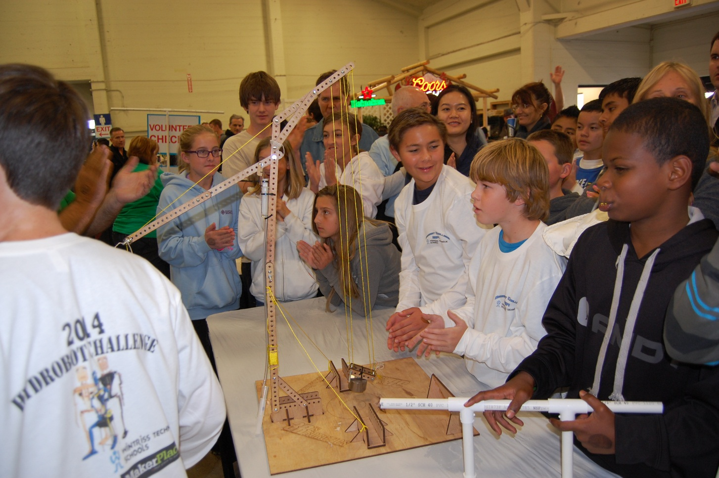
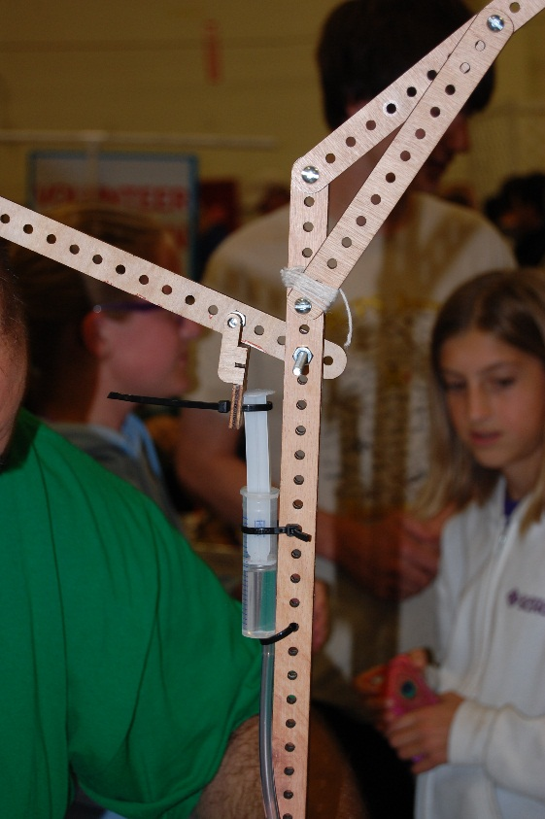
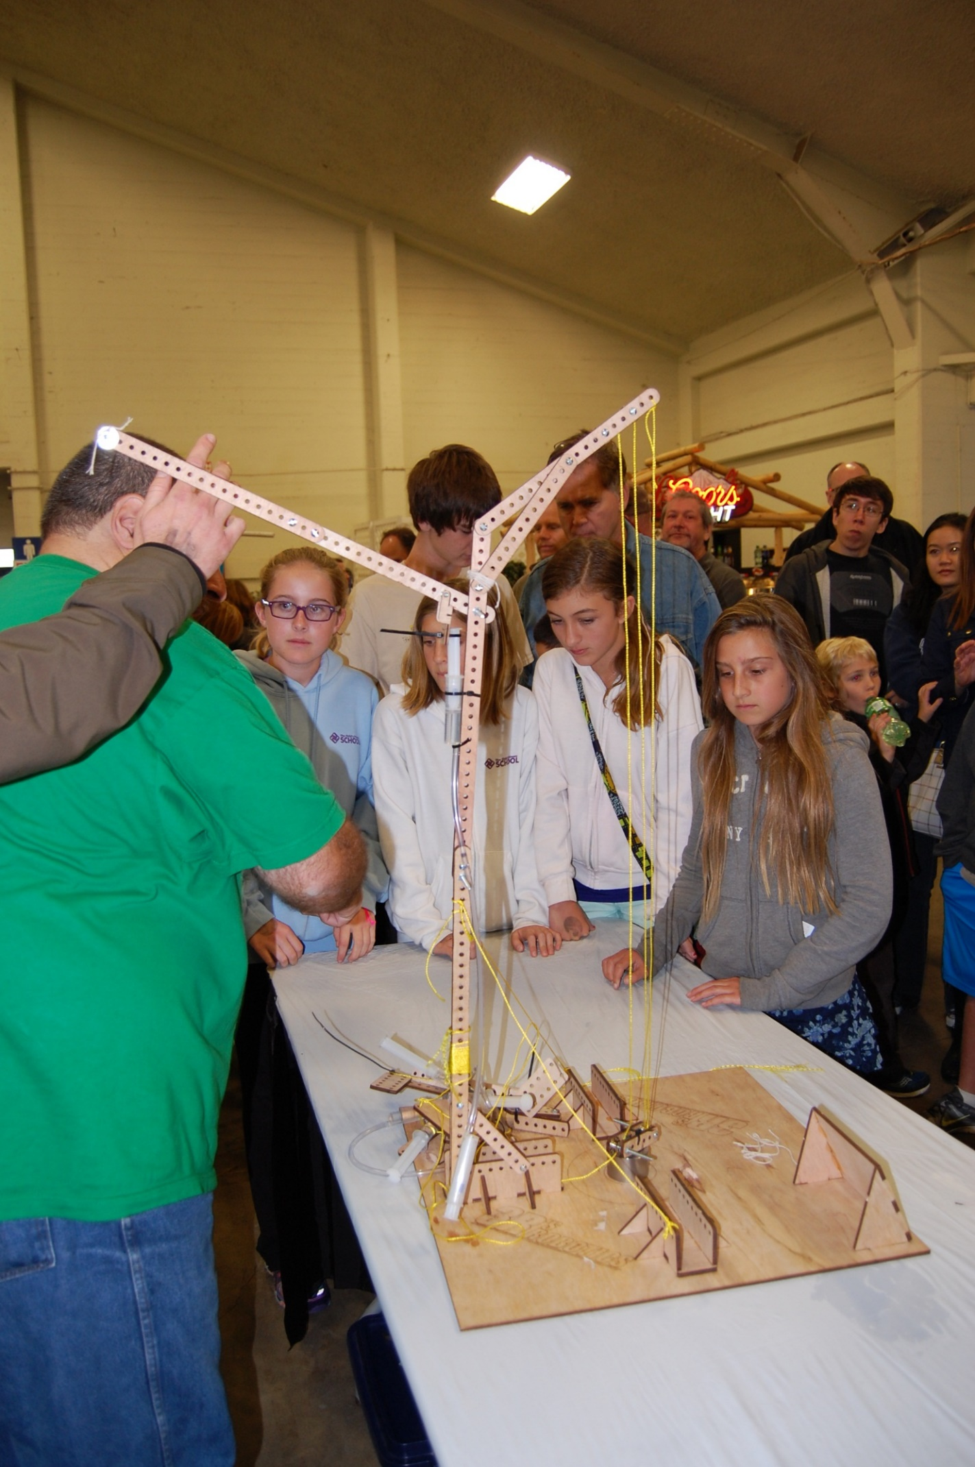
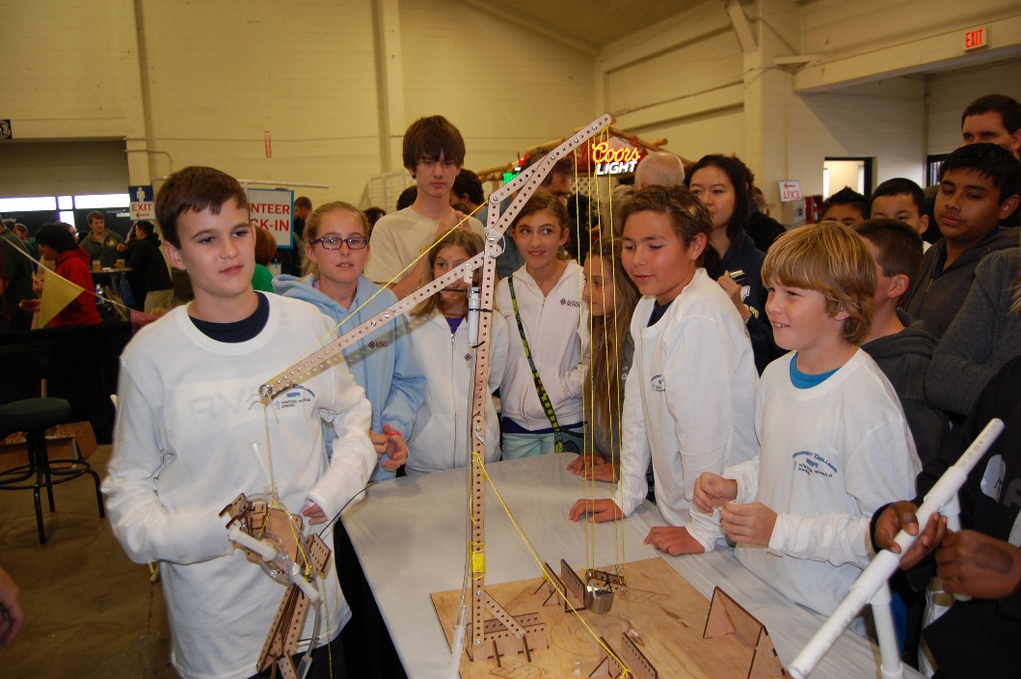

Slide 30

Success in any of the Super-Lift Challenges requires the creative use of pistons and cylinders. They are the best tool for creating and controlling force.
Notes:
Success in the Super-Lift challenge is really going to be dictated in how creative you are in the use of the pistons and cylinders in your overall design. Remember, it's not just about the hydraulic devices but how well the hydraulic devices are utilized and distribute force to the simple machines throughout the entire design.
Now put your cosmic thinking caps on and use your newfound knowledge to work.
,,,,
See you next time.

